Slide 1
Image Processing
BY : Ahmed Haytham
For
GDSC Damnhour

Slide 2
Data Preprocessing
Data Preprocessing includes the steps we need to follow to transform or encode data so that it may be easily parsed by the machine.

Slide 3
Color to Grayscale Conversion
1.1 RGB to Grayscale
There are a number of commonly used methods to convert an RGB image to a grayscale image such as average method and weighted method.
Average Method
The Average method takes the average value of R, G, and B as the grayscale value.
Grayscale = (R + G + B ) / 3.
Theoretically, the formula is 100% correct
Grayscale = R / 3 + G / 3 + B / 3.

Slide 4
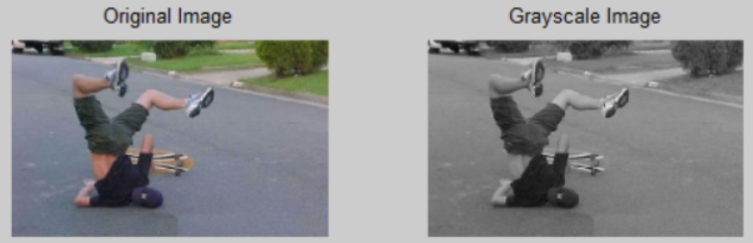
Color to Grayscale Conversion
1.1 RGB to Grayscale
The Weighted Method
The weighted method, also called luminosity method, weighs red, green and blue according to their wavelengths. The improved formula is as follows:
Grayscale = 0.299R + 0.587G + 0.114B

Slide 5
Color to Grayscale Conversion
1.2 YUV to Grayscale
YUV is a color encoding system used for analog television. The YUV color model represents the human perception of color more closely than the standard RGB model used in computer graphics hardware and is more size-efficient.
RGB to YUV Conversion
Y = 0.299R + 0.587G + 0.114B
U’= (B-Y)*0.565
V’= (R-Y)*0.713
The Grayscale Value
The formula for converting RGB to Y is the same as the formula for converting RGB to grayscale. Therefore:
Grayscale = Y

Slide 6
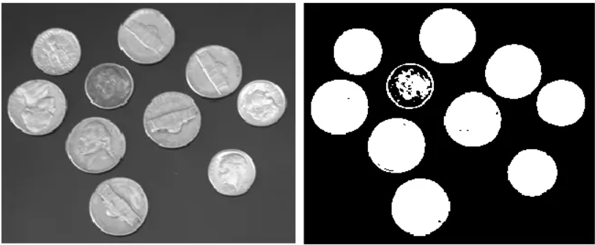
2.Binarization: Grayscale to black/white Conversion
Binarization converts a grayscale image to a black/white image. This transformation is useful in detecting blobs and further reduces the computational complexity. The critical task is to find a suitable threshold. There are two main methods:
Local thresholding — calculates the threshold pixel by pixel
Global thresholding — calculates the threshold once for all pixels

Slide 7
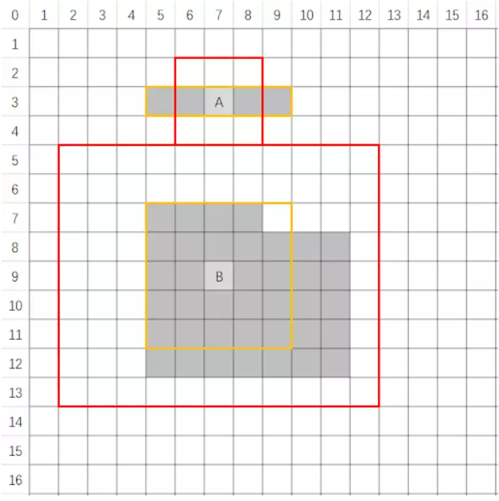
2.Binarization: Grayscale to black/white Conversion
2.1 Local Thresholding Method
With local thresholding method, a threshold is calculated at each pixel, which depends on some local statistics such as mean, range, and the variance of the pixel neighborhood. The image is divided into several sub-blocks and the distribution of gray-value in each block was analyzed.

Slide 8
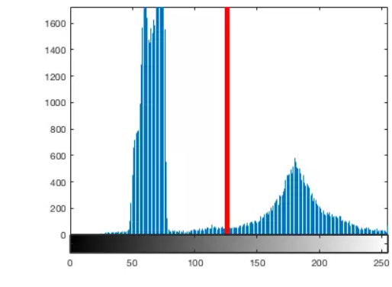
2.Binarization: Grayscale to black/white Conversion
2.2 Global Thresholding Method
The global thresholding method take advantage of the image histogram. The image histogram is a type of statistical graph with grayscale value on the x-axis and the number of pixels for each grayscale on the y-axis.
Image histogram can be used to automatically determine the value of the threshold to be used for converting a grayscale image to a binary image. The basic idea is to find a point between the peak of the foreground pixel values and the peak of the background pixel values. If the intensity level of a pixel is smaller than the threshold, the pixel is set to black (grayscale = 0), otherwise, it is set to white (grayscale = 255). The threshold serves as a dividing line.

Slide 9
Filtering Techniques
Filtering is a method for enhancing or altering an image . There are mainly two types of filtering:
• Spatial Filtering
• Frequency Filtering
spatial : filtering, the processed pixel value for the existing pixel is
dependent on both itself and neighboring pixels
Frequency : filters are used to process an image in the frequency domain.
The image is converted to frequency domain by using a Fourier transform
function. After frequency domain processing, the image is transformed into
the spatial domain by inverse Fourier transform
Therefore, spatial
filtering is a neighboring procedure, where the value of any particular pixel
in the output image is calculated by applying some algorithm to the values
of the neighboring pixels of the corresponding input pixel

Slide 10
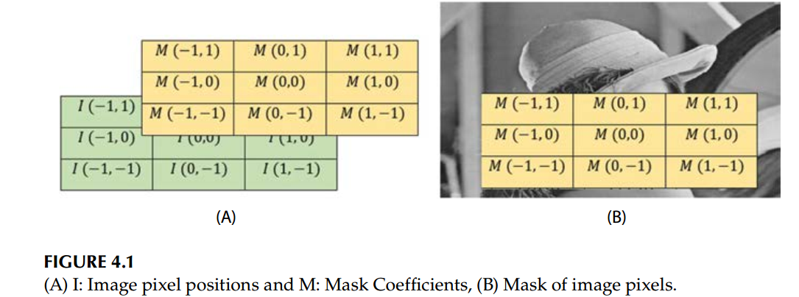
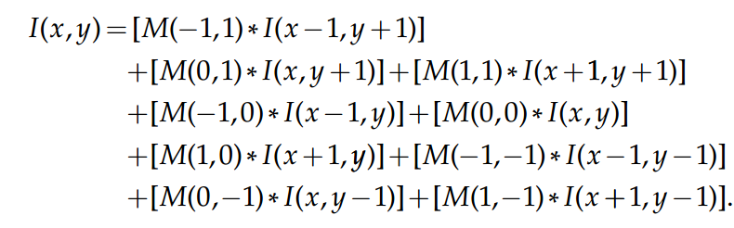
Spatial Filter
Linear Filter (Convolution)
Nonlinear Filter
The result of the linear filtering is the summation of products of the mask
coefficients with the equivalent pixels exactly beneath the mask
Nonlinear spatial filtering also works on neighborhoods, as discussed in the
case of linear filtering . The only difference is the nonlinear filtering is
based conditionally on the values of the neighboring pixels of a relative pixel

Slide 11
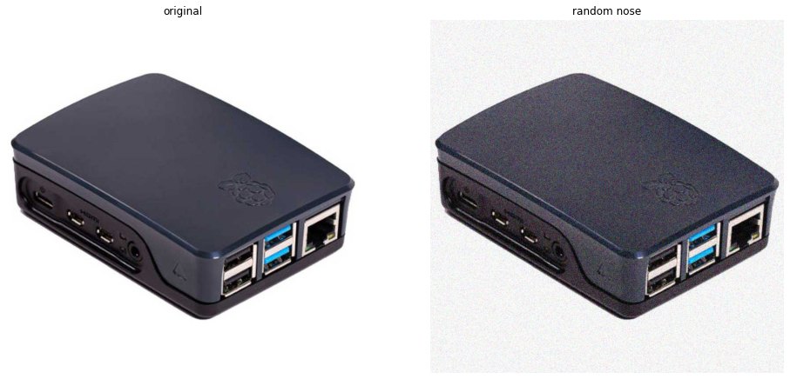
Spatial Filter
Smoothing Filter
Smoothing filters are mainly used to reduce noise of an image and for blurring. Blurring is used to remove unimportant information from an image prior to feature extraction, and is used to connect small breaks in curves or lines. Blurring is also used to reduce noise from an image. A smoothing filter is also useful for highlighting gross details.

Slide 12
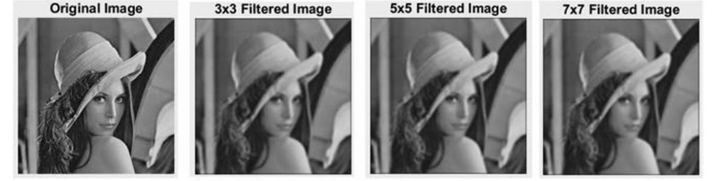
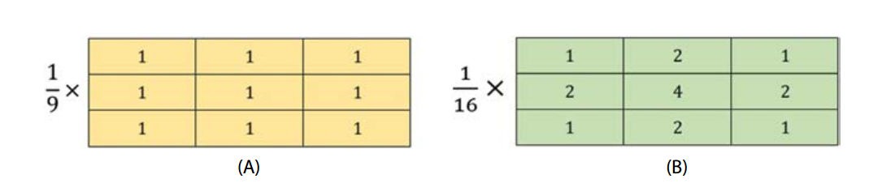
Spatial Filter
Smoothing Linear Filters
A smoothing linear filter is basically the mean of the neighborhood pixels of the filter mask
The concept entails substituting the value of every single
pixel in an image with the mean of the neighborhood pixels defined by the filter mask

Slide 13
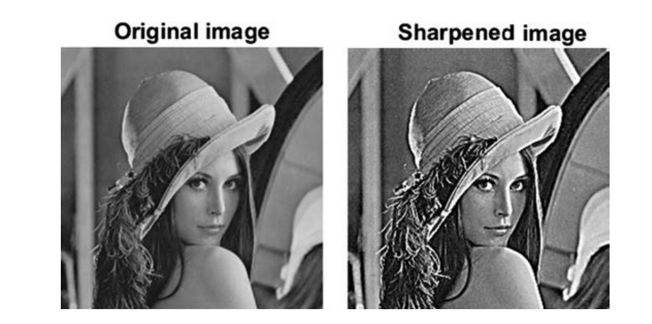
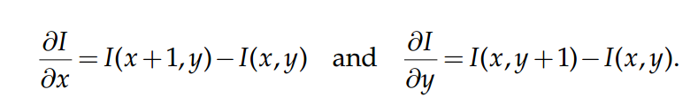
Spatial Filter
Sharpening Filter
The primary goal of this filter is to enhance the fine detail in an image or to
highlight the blurred detail
Sharpening can be performed by using spatial derivatives, which can be applied in areas of ﬂat regions or constant gray level
regions

Slide 14
Frequency Filter
Frequency filters are used to process an image in the frequency domain .The image is converted to frequency domain by using a Fourier transform function.
Ideal,
Butterworth, and
Gaussian
Low-Pass Filter
A low-pass filter is a filter that passes or allows low-frequency signals, and suppresses signals with higher frequencies than the cutoff or threshold frequency

Slide 15
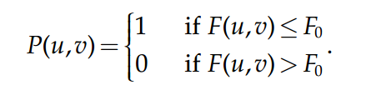
Frequency Filter
Ideal Low-Pass Filter (ILP)
This is the simplest low-pass filter that suppresses all high-frequency
components of the Fourier Transform that are greater than a specified

Slide 16
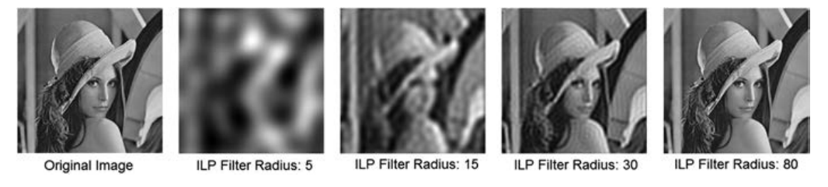
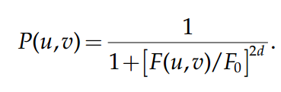
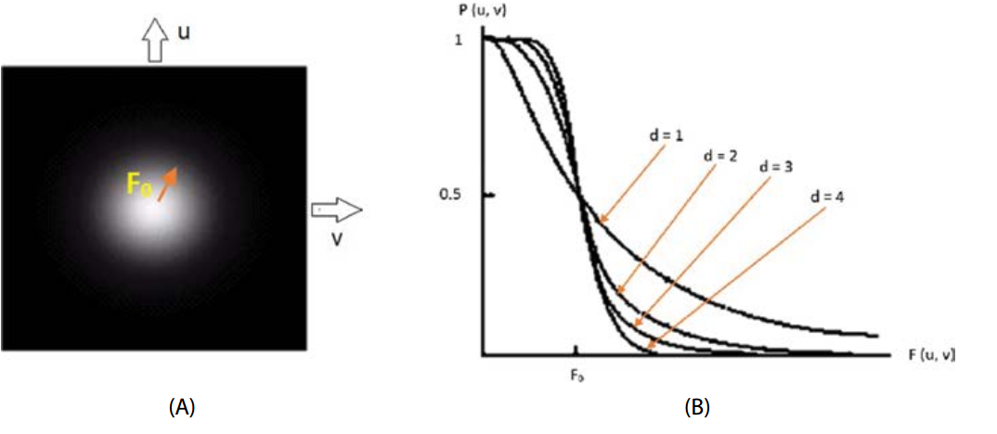
Frequency Filter
Butterworth Low-Pass Filter (BLP)
This filter is used to eliminate high frequency noise with the least loss of
image data in the specified pass band with order d.

Slide 17
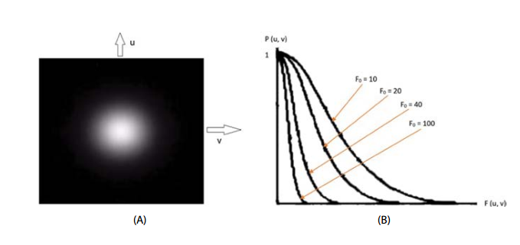
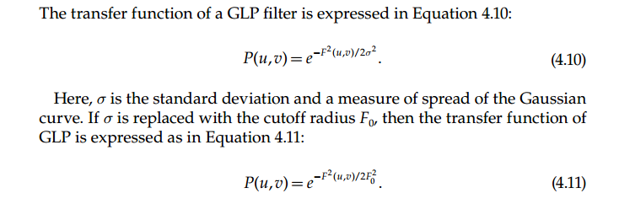
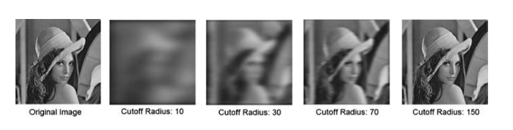
Frequency Filter
Gaussian Low-Pass Filter (GLP)

Slide 18
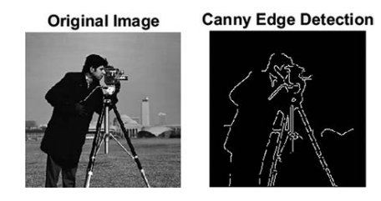
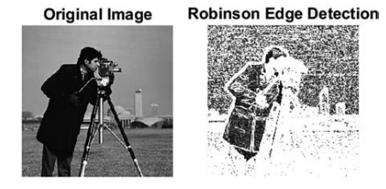
Edge detection
Edge detection is a technique of image processing used to identify points in a digital image with discontinuities, simply to say, sharp changes in the image brightness. These points where the image brightness varies sharply are called the edges (or boundaries) of the image.

Slide 19
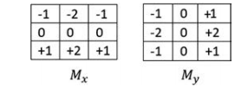
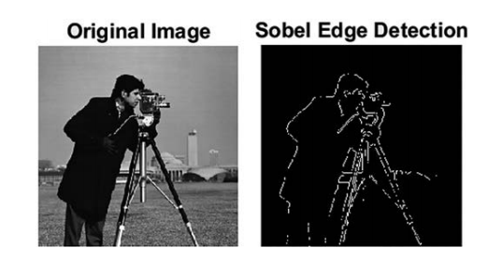
Edge detection
Sobel Edge Detector
The Sobel edge detection method uses the Sobel approximation to the derivative to highlight edges . It leads the edges at those points where the gradient is highest. The operator comprises of a pair of 3 × 3 kernels, or masks

Slide 20
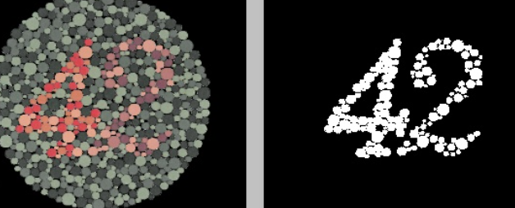
Segmentation
Image segmentation is the procedure of separating an image into several
parts

Slide 21
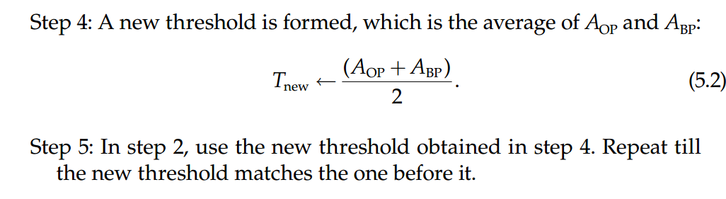
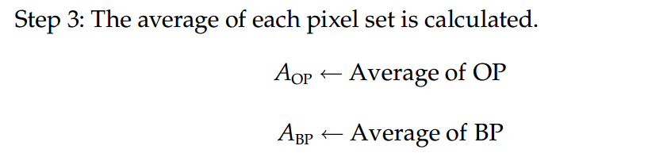
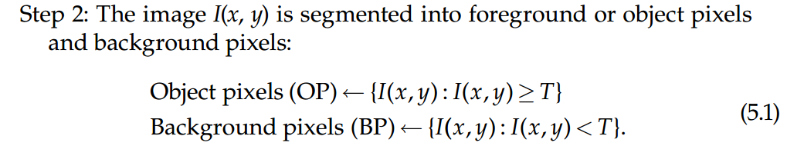
Segmentation
Thresholding
Thresholding is a procedure of transforming an input grayscale image
into a binarized image, or image with a new range of gray level, by using a
particular threshold value

Slide 22
Segmentation
Thresholding
Thresholding is a procedure of transforming an input grayscale image
into a binarized image, or image with a new range of gray level, by using a
particular threshold value

Slide 23
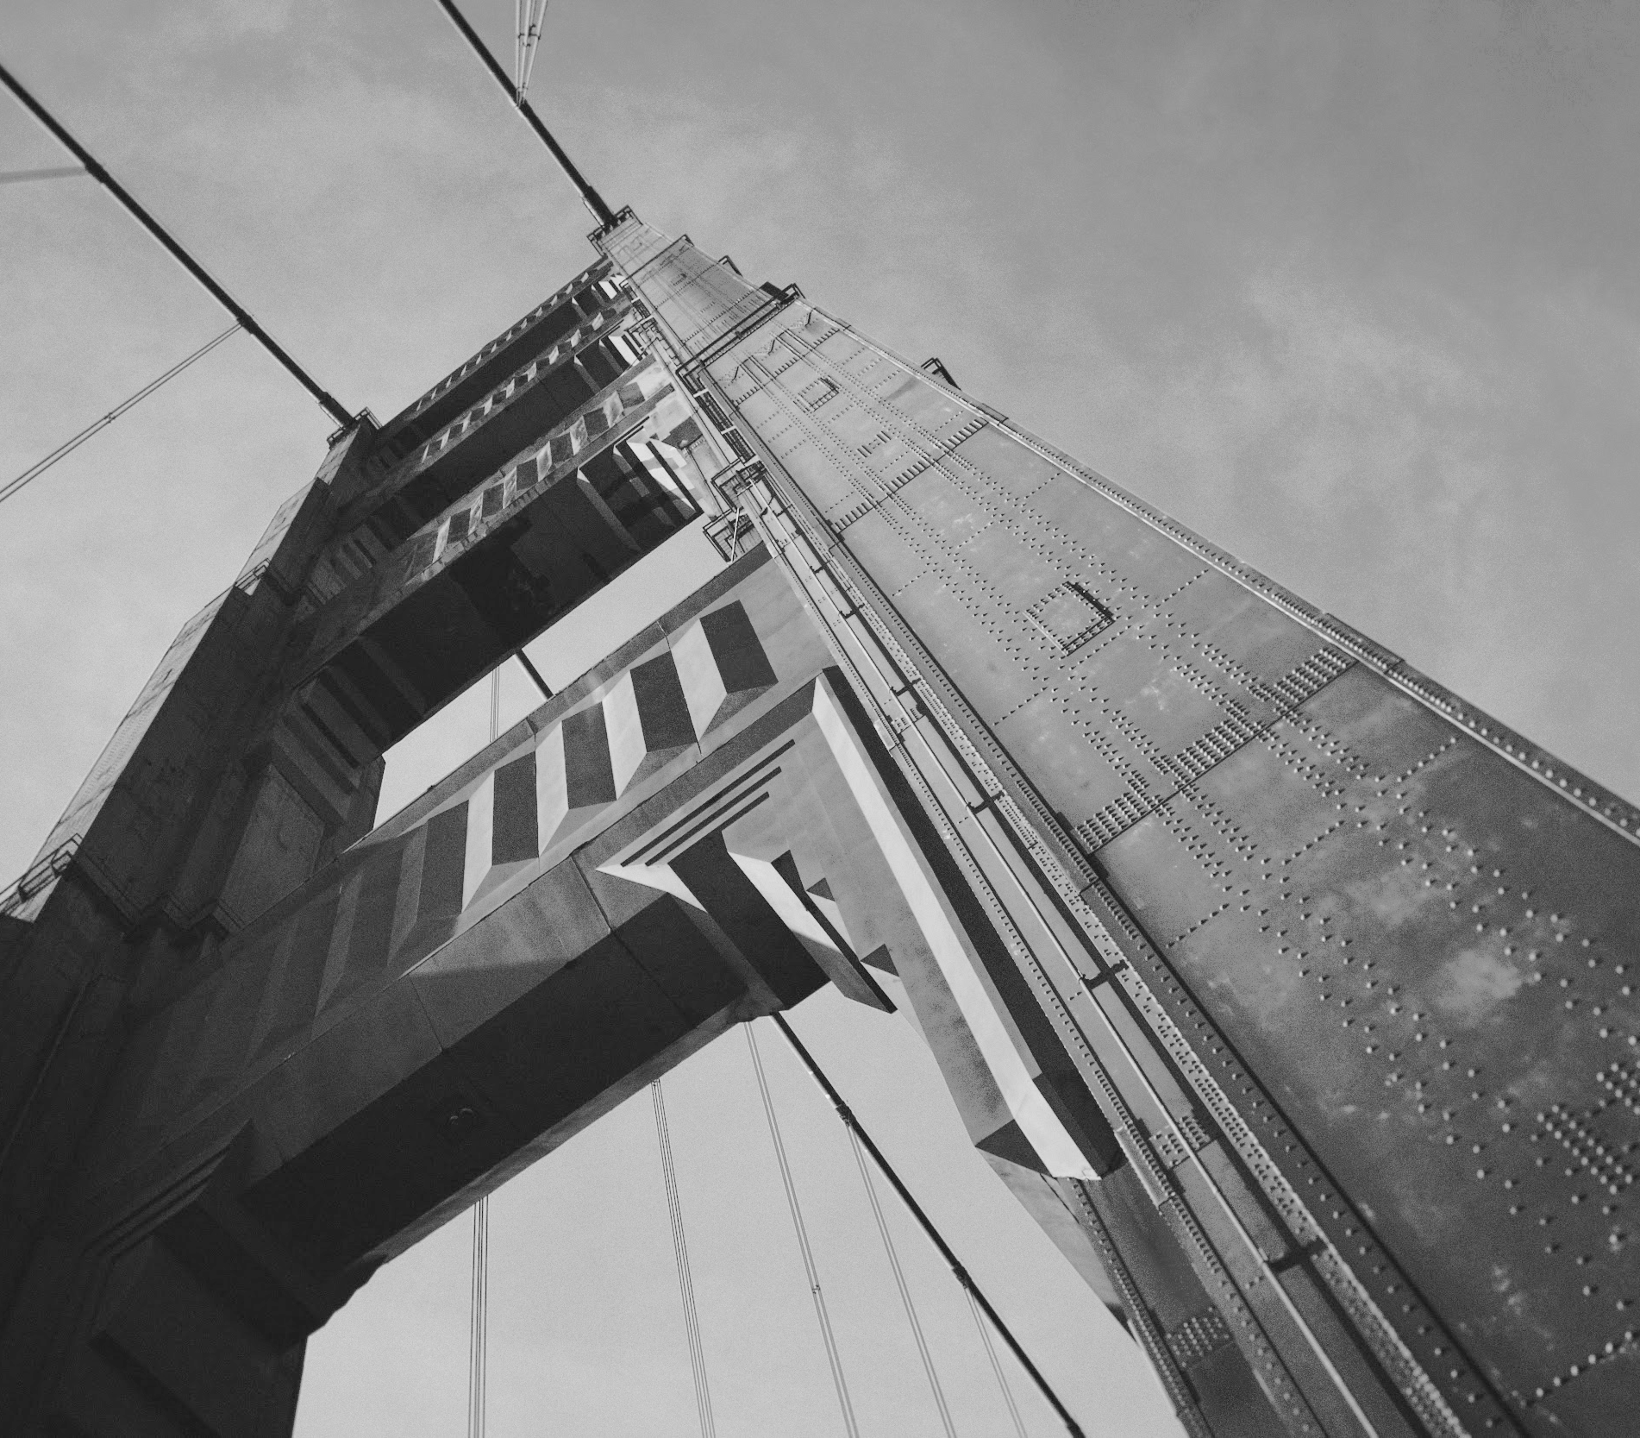
Thanks!

